Slide 1
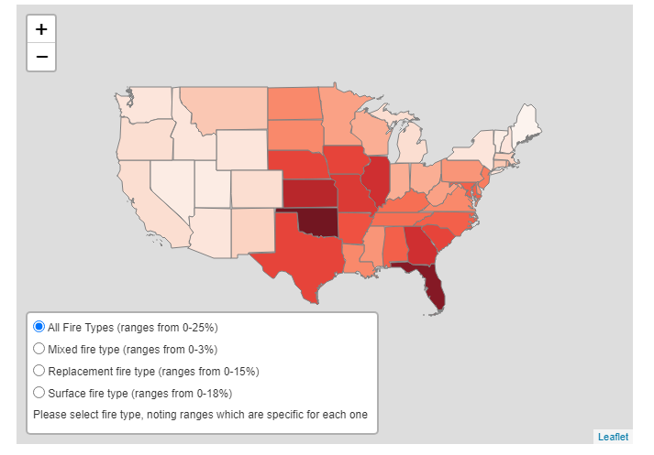
There was lots of fire title
Explain with minimal text here
Also fix up map:
Change basemap
Fix projection if possible
Are colors OK?

Slide 2
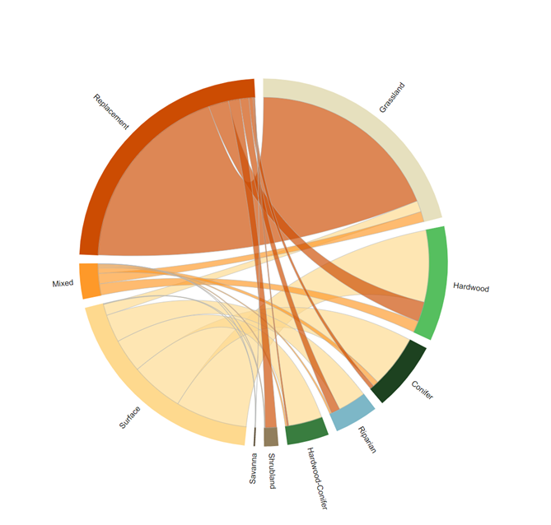
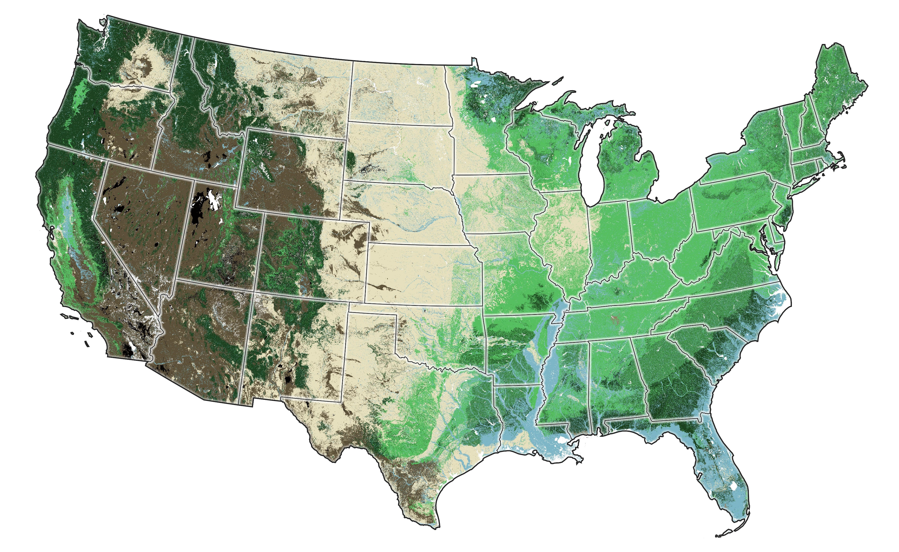
Where did the fire occur?
Minimal explanatory text
Downloadable map of
historical group veg

Slide 3
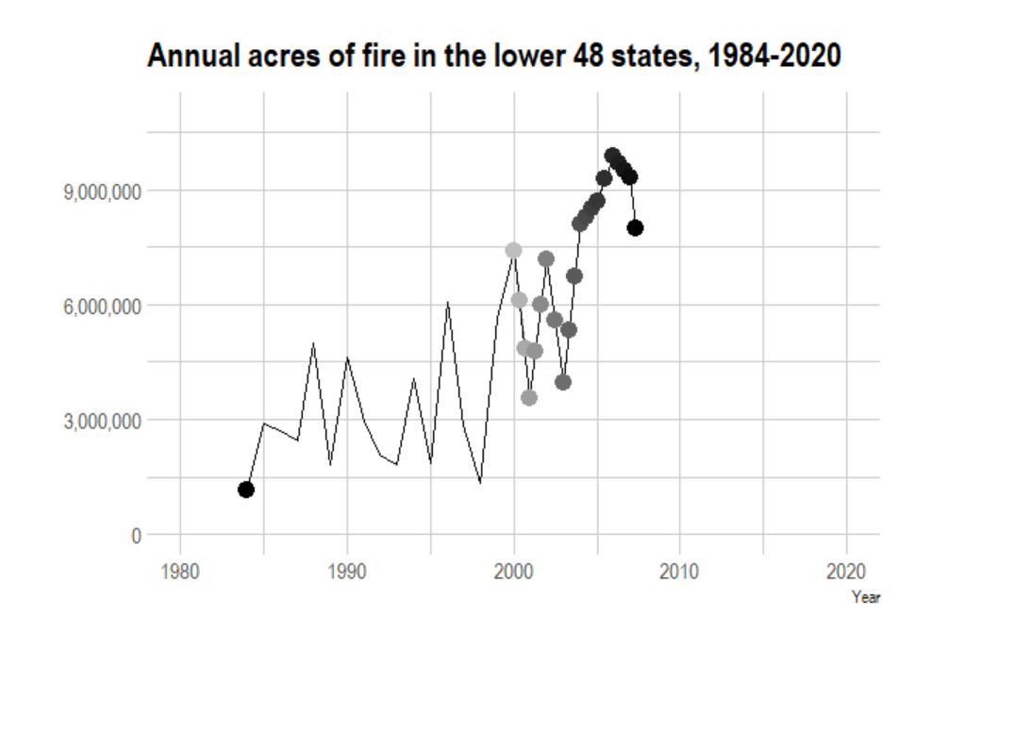
Moving line graph (data - current acres over time) (on tab called "modern fires" here) - we hope to split this out by region, or by fire type (low, mid, high severity)

Slide 4
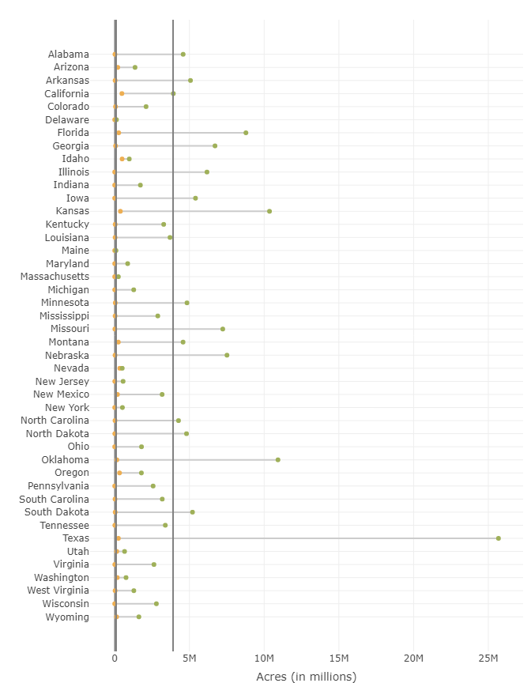
Then and now

Slide 5

Chord diagram - (data - fire type per ecosystem) (on tab called "histo chord" here) Notes: will include some explanation to guide interpretation; will make the outer ring color more "gentle and one color"

Slide 6
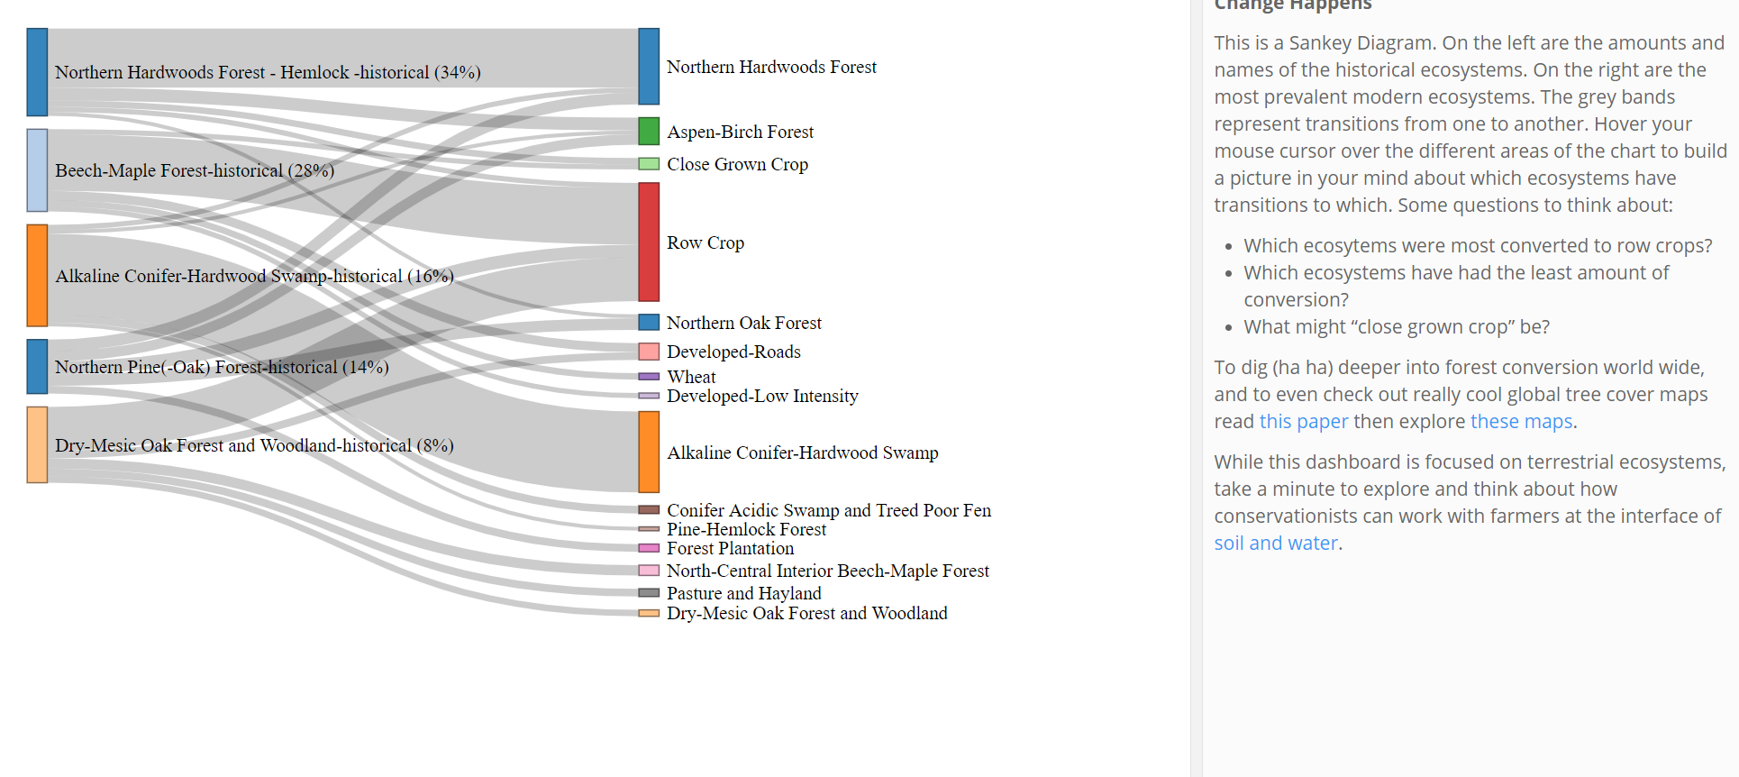
Sankey diagram - (data - ecosystem type conversion) (on tab called "change" here)

